Slide 1
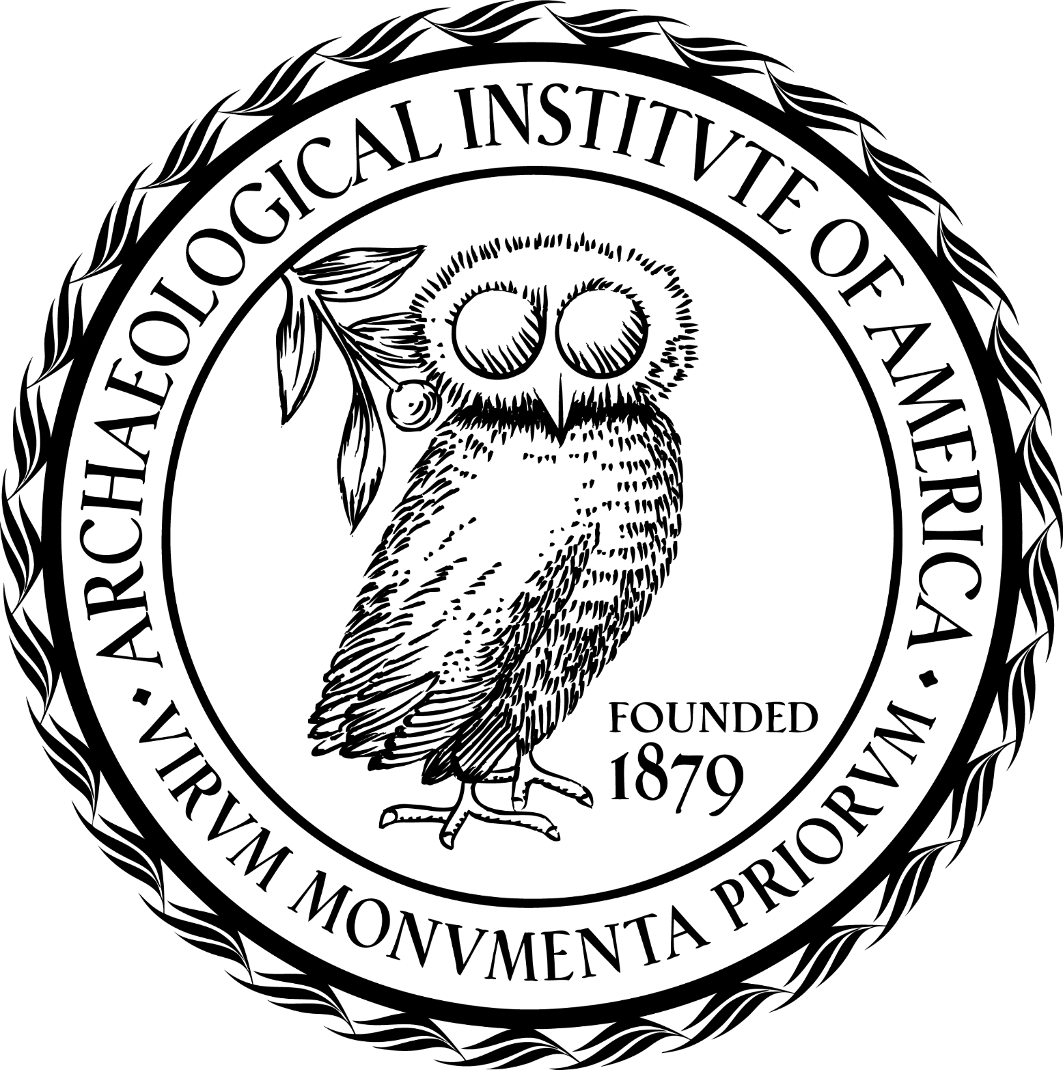
Archaeological Institute of America
excavate
educate
advocate
Max Arthur Cohn and Sarah Waldstein Cohn Memorial Lecture
www.archaeological.org

