Slide 1
Archaeological Institute of America
excavate
educate
advocate
National Lecture Program
@archaeology_aia
@Archaeological.Institute
@archaeology_aia
ArchaeologyTV
www.archaeological.org

Slide 2
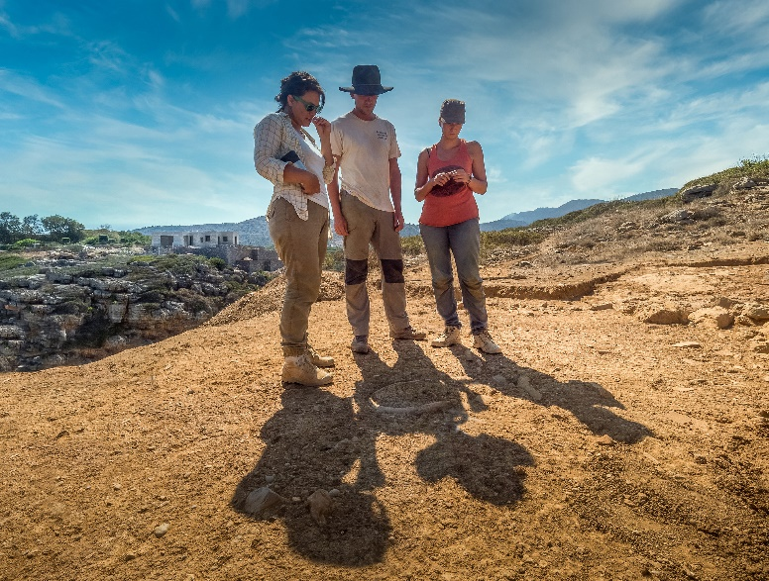
We make archaeology happen
and we have since 1879
The AIA is North America’s largest and oldest archaeological organization with over 200,000 members worldwide.
We support:
Archaeologists
Educators
Excavations
Publications
Research
Site Preservation
Our programs and publications keep you up-to-date with archaeological discoveries and research from around the world.
Photo: Gavin McGuire
www.archaeological.org

Slide 3
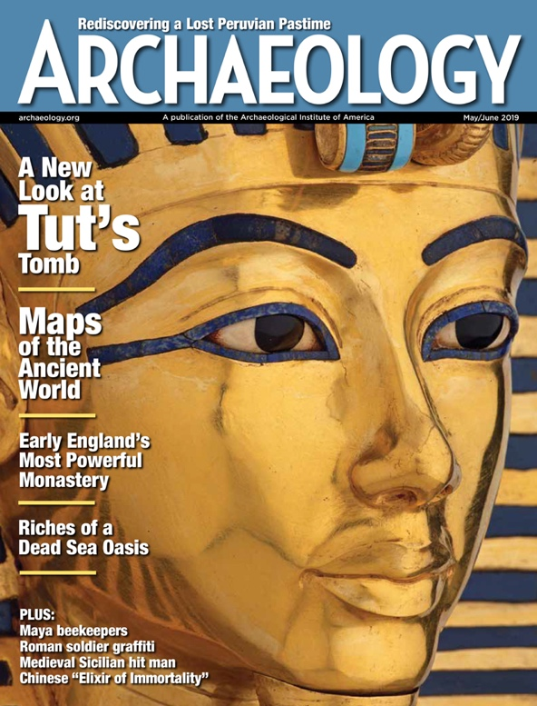
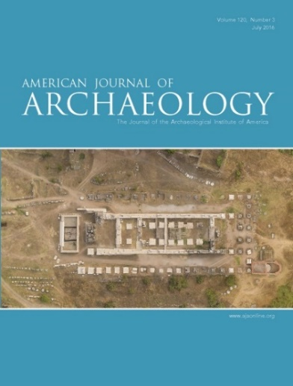
Read all about it
in our engaging publications
Archaeology magazine, with a readership of over 700,000 per issue, includes in-depth stories, archaeological highlights from around the world, and spectacular images that bring the past to vivid life.
Find out more at archaeology.org.
Want more? The American Journal of Archaeology
is the world’s leading journal of Mediterranean archaeology. Find out more at ajaonline.org.
www.archaeological.org

Slide 4
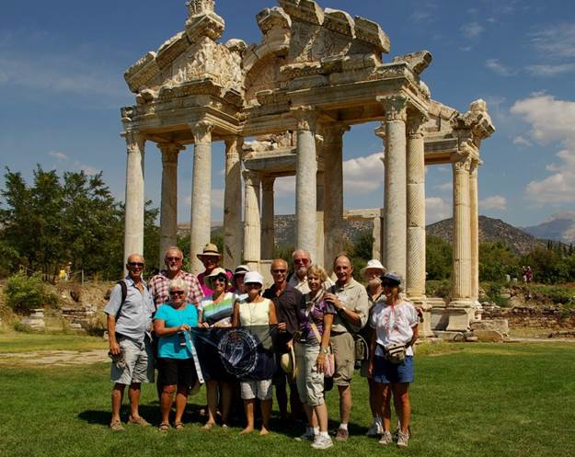
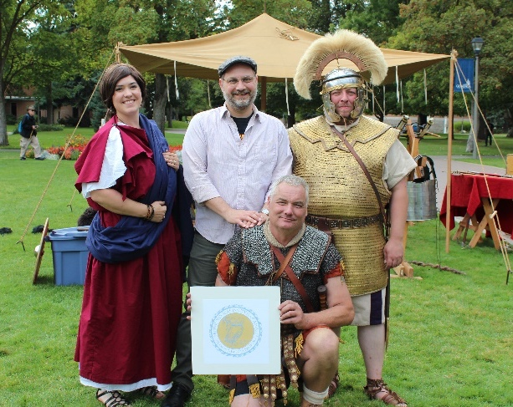
Dig in
and experience archaeology with the AIA
Attend a lecture, an archaeology fair, or other local event organized by the AIA, our Local Societies, or Collaborating Organizations.
Photo: J. S. MacLean
Photo: AIA Tours
Find an excavation on our extensive list of fieldwork opportunities.
Visit spectacular archaeological sites around the world with AIA Tours.
Photo: A. Goldman
www.archaeological.org

Slide 5
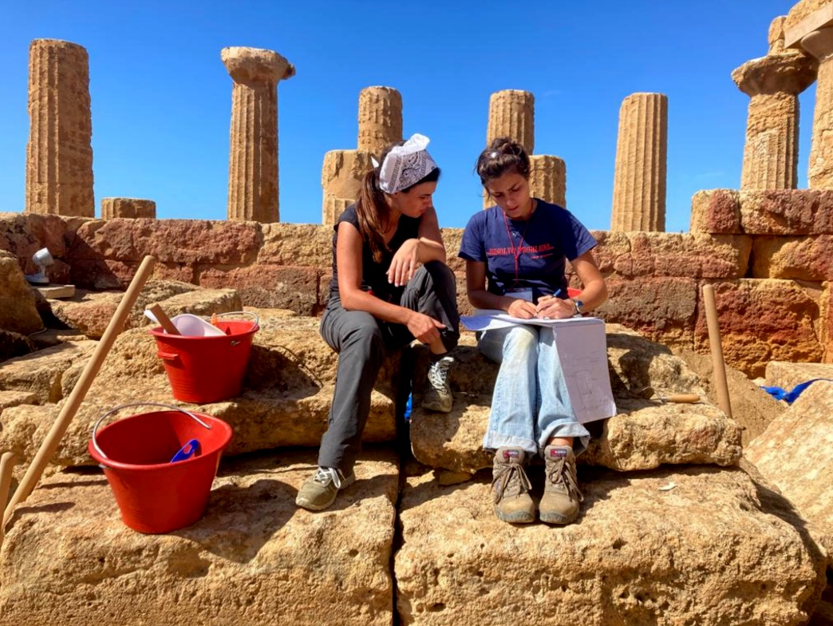
Join the AIA
and indulge your passion for archaeology
Become a part of the adventure today
Uncover the past
Experience the thrill of discovery
Enjoy exclusive member benefits
Photo: Gavin McGuire
archaeological.org/join
www.archaeological.org

Slide 6
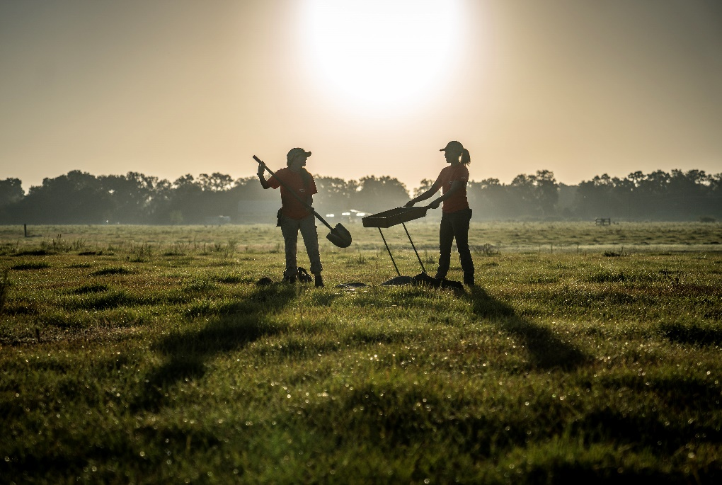
Support the AIA
and make archaeology possible
As a nonprofit, we rely on the generosity of donors to support our mission. Your gift makes archaeological research, site preservation, publications, and programs possible.
archaeological.org/donate
text to donate: 833-965-2840
Photo: Niki Gail
www.archaeological.org

