Slide 1

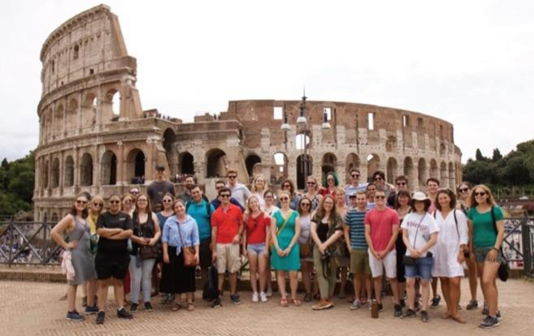
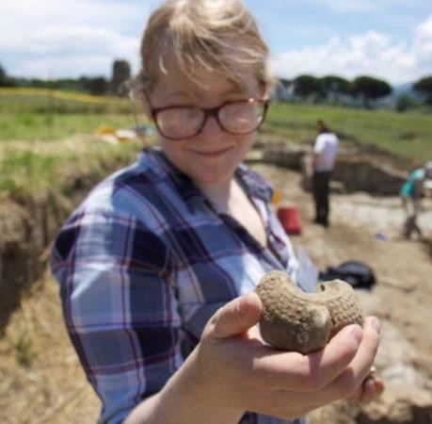
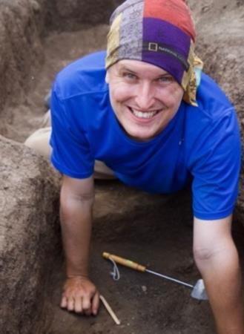
The Gabii Project: Summer Field School in Archaeology
Rome, Italy June 13 – July 17, 2027
About the Gabii Project
We are an international archaeological initiative affiliated with the Department of Classics, Archaeology, and Religion at Mizzou and led by Prof. Marcello Mogetta. We have been excavating the Latin city of Gabii since 2007 to study the formation and growth of a city-state that was a neighbor and rival to Rome in the first millennium BCE,. Our research tackles big questions about Roman urbanism in ancient Italy through the integration of spatial data, architecture and stratigraphy, and a wide variety of finds spanning from the Iron Age to Late Antiquity.
,
What you will learn
The archaeology of Rome and Latium, including guided trips to select sites and museums and off-site lectures
Excavation and interpretation of ancient Gabii
Digital, cutting-edge recording techniques
Scientific processes, including environmental and biological analysis
What is included
Program costs: $6,450 (or $6,000 for returners).
Accommodations in Frascati
(Metropolitan Area of Rome).
Room and board (breakfast and dinners).
Travel and health insurance, equipment, local transportation, weekday lunches, select museum fees.
24/7 logistical support.
Not included: international flights.
APPLY NOW!
Submit your early-action application online at https://gabiiproject.org/apply-now/ by December 1, 2026.
We are willing to facilitate arrangements to help students get credit from their home institutions.
Questions about the program?
Visit the project’s website:
gabiiproject.org
Contact Prof. Mogetta: gabii.project@gmail.com

