Slide 1
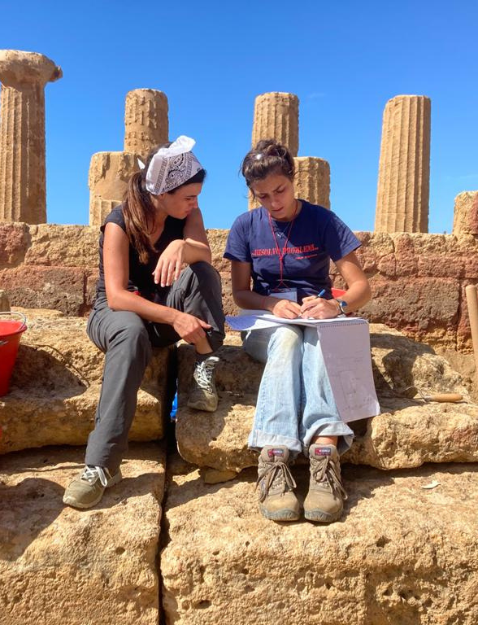
Archaeological Institute of America
Excavate ⬩ Educate ⬩ Advocate
National Lecture Program
@archaeology_aia
@Archaeological.Institute
@archaeology_aia
@ArchaeologyTV
www. archaeological.org

Slide 2
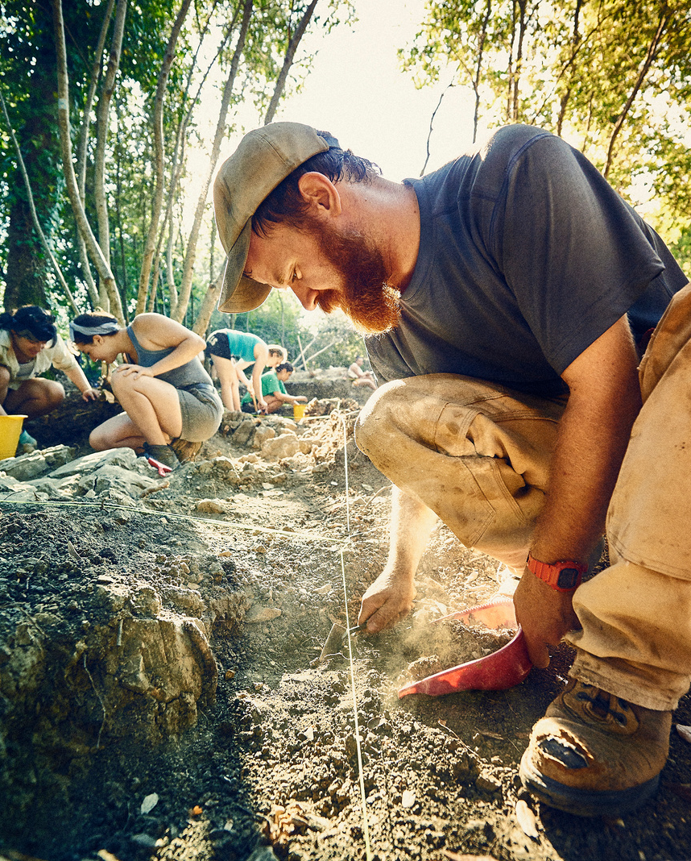
Since 1879
Making Archaeology Happen
The AIA is North America's largest and oldest archaeological organization with nearly 200,000 members worldwide
We Support:
Our programs and publications keep you up-to-date with archaeological discoveries and research from around the world.
Archaeologists
Educators
Excavations
Publications
Research
Site Preservation
Excavate ⬩ Educate ⬩ Advocate
www. archaeological.org

Slide 3
Publications
Read All About It
ARCHAEOLOGY magazine, with a readership of over 700,000 per issue, includes in-depth stories, archaeological highlights from around the world, and spectacular images that bring the past to vivid life. Find out more at archaeology.org
Want more? The American Journal of Archaeology (AJA) is the worlds leading journal of Mediterranean archaeology. Find out more at ajaonline.org
Excavate ⬩ Educate ⬩ Advocate
www. archaeological.org

Slide 4
Dig In
Experience Archaeology
Attend a lecture, an archaeology fair, or other local event organized by the AIA, our Local Societies, or Collaborating Organizations.
Find an excavation on our extensive list of fieldwork opportunities.
Visit spectacular archaeological sites around the world with AIA Tours.
Excavate ⬩ Educate ⬩ Advocate
www. archaeological.org

Slide 5
Join Us
Indulge Your Passion
Enjoy Exclusive Member Benefits:
Eligibility for AIA Fellowships and Grants
Affiliation with an AIA Local Society
Discounts on Annual Meeting Registration
Ability to serve on AIA Committees
ARCHAEOLOGY and AJA Subscriptions
$100 off first AIA Tour
And Many More!
Excavate ⬩ Educate ⬩ Advocate
www. archaeological.org

Slide 6
Donate
Support The AIA
As a nonprofit, we rely on the generosity of donors to support our mission. Your gift makes archaeological research, site preservation, publications, and programs possible.
archaeological.org/donate
Excavate ⬩ Educate ⬩ Advocate
www. archaeological.org

